Slide 1

DIGITAL SYSTEM AND MICROPROCESSOR (18B11EC311)
SIGNAL AND SYSTEMS

Slide 6
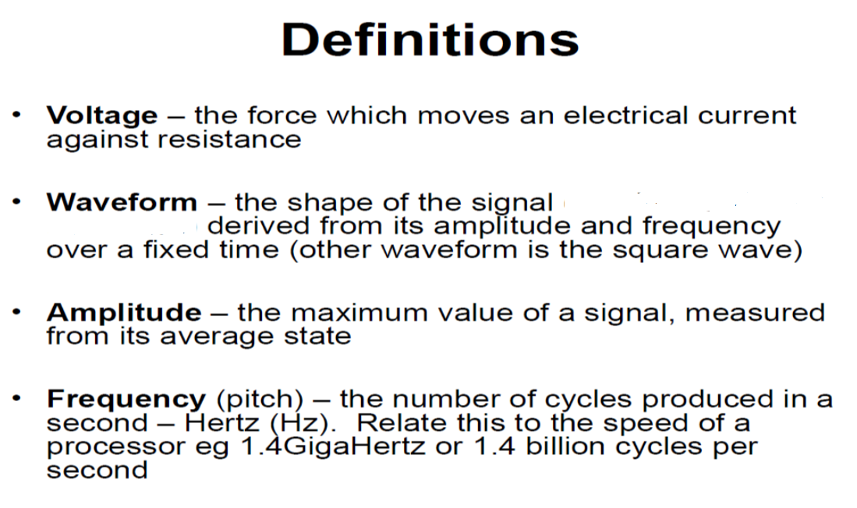

Slide 15
Analog | Digital
An analog signal is a continuous signal that represents physical measurements. | Digital signals are time separated signals which are generated using digital modulation.
It is denoted by sine waves | It is denoted by square waves
It uses a continuous range of values that help you to represent information. | Digital signal uses discrete 0 and 1 to represent information.
Temperature sensors, FM radio signals, Photocells, Light sensor, Resistive touch screen are examples of Analog signals. | Computers, CDs, DVDs are some examples of Digital signal.
The analog signal bandwidth is low | The digital signal bandwidth is high.
Analog signals are deteriorated by noise throughout transmission as well as write/read cycle. | Relatively a noise-immune system without deterioration during the transmission process and write/read cycle.
Analog hardware never offers flexible implementation. | Digital hardware offers flexibility in implementation.
It is suited for audio and video transmission. | It is suited for Computing and digital electronics.
Processing can be done in real-time and consumes lesser bandwidth compared to a digital signal. | It never gives a guarantee that digital signal processing can be performed in real time.
Analog instruments usually have s scale which is cramped at lower end and gives considerable observational errors. | Digital instruments never cause any kind of observational errors.
Analog signal doesn’t offer any fixed range. | Digital signal has a finite number, i.e., 0 and 1.

Slide 19
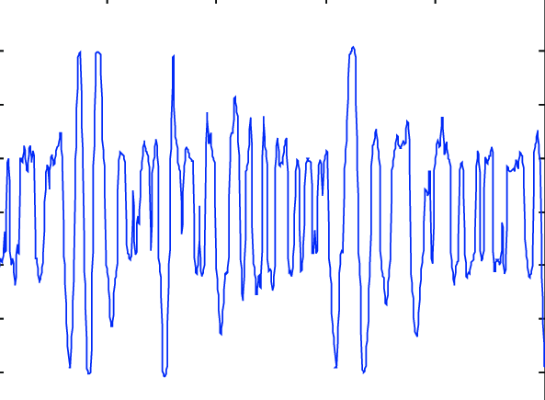
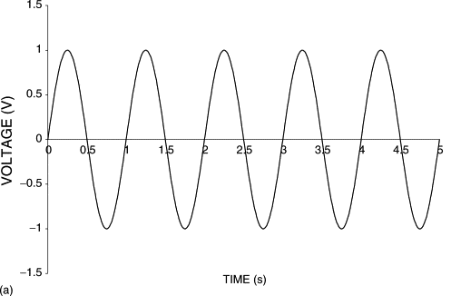
Deterministic continuous signal
Random continuous signal

